Slide 1
Overtaking

Slide 2
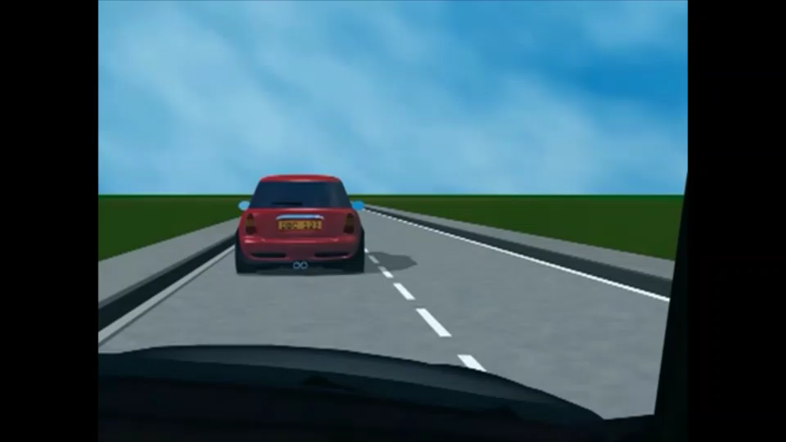
When can I overtake?
Check if the road is clear using your mirrors and signal before acting
Overtake quickly and move back to the right
Do NOT accelerate while being overtaken
Give way to cars coming to you from the opposite direction
On motorways never overtake on the right side

Slide 3
When should I NOT overtake?
When coming to a junction, a crossing, a corner or bend, a bridge or a hill.
When the road narrows.
When you might hinder another cars.
When you would have to violate rules for lines and lanes.
When there is a "no overtaking" road sign.

Slide 4
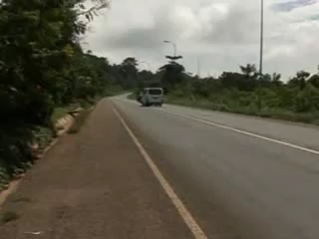
Do NOT overtake on a curve.

Slide 5
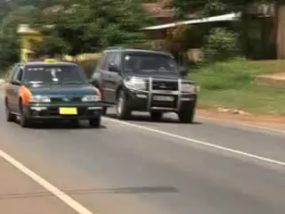
Do NOT overtake two cars.

Slide 6
Dangers of overtaking.

